Slide 1


CATCHING TRANSACTIONS FRAUD USING MACHINE LEARNING

Slide 2

GLIMPSE
Spotting fraud in financial transactions is a tough job, but machine learning makes it easier. In this presentation, I’ll show how we built a fraud detection system using techniques like logistic regression and decision trees. We also tested other models to find the best fit for detecting unusual patterns. The goal was to create a system that’s both accurate and reliable in catching fraudulent activities.

Slide 3


Dataset & Preprocessing:
Exploratory Data Analysis (EDA):
Machine Learning Approach:
ABSTRACT
Utilized real-world datasets with imbalanced class distributions.
Preprocessing steps included handling missing values, feature scaling, and encoding categorical data.
Conducted statistical and visual analysis to understand data distributions, class imbalances, and feature correlations.
Implemented a Logistic Regression and Decision Tree model for binary classification of fraudulent and legitimate transactions.

Slide 4

DATASET DESCRIPTION
SOURCE
KAGGLE
TOTAL THERE ARE 11 COLUMNS AND 6362615 ROWS IN OUR DATASET
SIZE
WE HAVE (6354407) LEGIT TRANSACTION AND (8213) FRAUD TRANSACTION
CLASS IMBALANCE
CASH_OUT 2237500
PAYMENT 2151495
CASH_IN 1399284
TRANSFER 532909
DEBIT 41432
PAYMENT TYPES

Slide 5


DATA PREPROCESSING
Handling Missing Values
Identified and filled missing values in the dataset to ensure data completeness and prevent errors during model training.
Class Imbalance Handling
Analyzed the class distribution and planned for methods to address imbalances, though explicit sampling techniques like SMOTE were not applied in the code.
Scaling Numerical Features
Applied StandardScaler and MinMaxScaler to normalize numeric data.
This step ensured all features had a comparable scale, improving model performance and convergence.
Splitting Data into Training and Testing Sets
Divided the dataset into training and testing subsets (e.g., 80:20 ratio).
Ensured that the model was trained on one set of data and evaluated on unseen data for fair performance measurement.
Encoding Categorical Variables
One-Hot Encoding: Transformed categorical variables into binary columns, making them suitable for machine learning models.
Label Encoding: Converted categorical labels into numeric codes for algorithms that require numerical inputs.

Slide 6


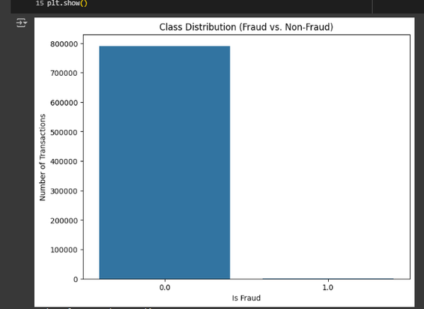
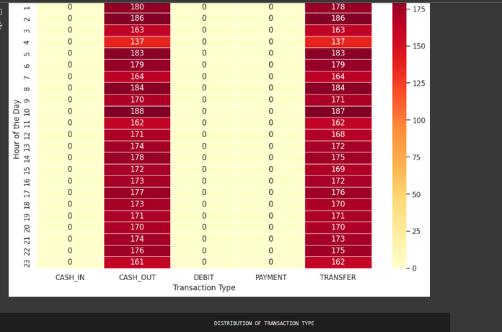
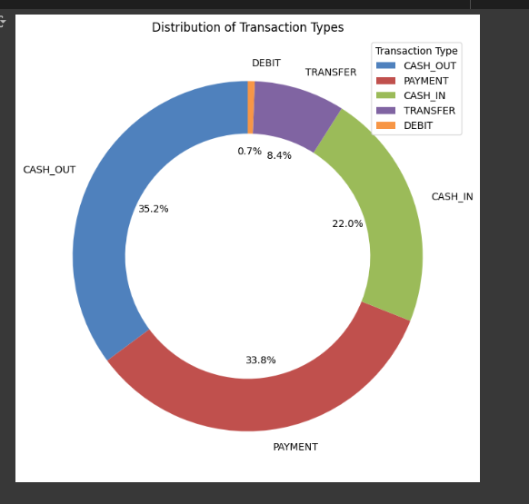
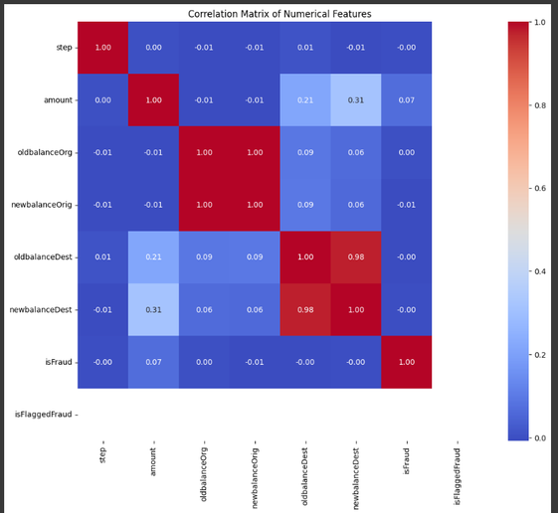
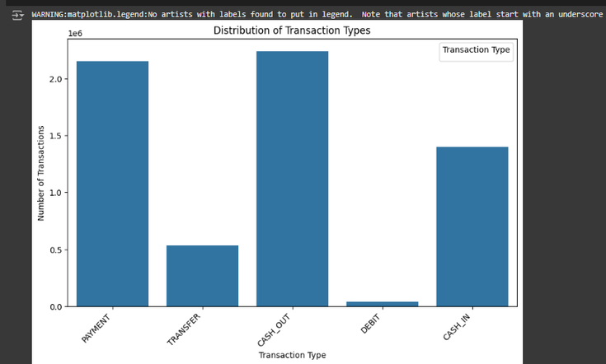
EXPLORATORY DATA ANALYSIS (EDA)
--> Visualized class imbalance with bar charts.
--> Analyzed feature correlations using a heatmap.
-->Identified outliers using the IQR method.
-->Included plots like heatmaps and class distributions.

Slide 7
MODEL SELECTION
LOGISTIC REGRESSION
Decision Tree Classifier:
Chosen for its efficiency and effectiveness in binary classification problems.
Selected as an initial model due to its simplicity and interpretability.
Logistic Regression provides a probabilistic framework, making it ideal for understanding the likelihood of transactions being fraudulent or legitimate.
Decision Trees are well-suited for binary classification as they can handle non-linear relationships and mixed data types without extensive preprocessing.
It served as a complementary model to validate and compare results against the Decision Tree.
Used as a baseline model to understand the underlying patterns and feature importance in the dataset.

Slide 8

MODEL TRAINING
Data Splitting:
Hyperparameter Tuning:
Divided the dataset into training (80%) and testing (20%) subsets to ensure proper evaluation of the model on unseen data.
Adjusted parameters such as max_depth for Decision Trees to avoid overfitting.
Model Implementation:
Trained two models:
Decision Tree Classifier: Used to capture complex, non-linear relationships in the data.
Logistic Regression: Implemented as a baseline model for comparison and simplicity.

Slide 9

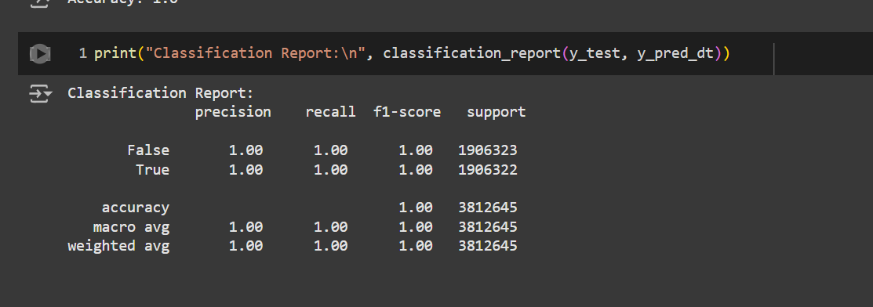
MODEL EVALUATION
Decision Tree Classifier:

Slide 10
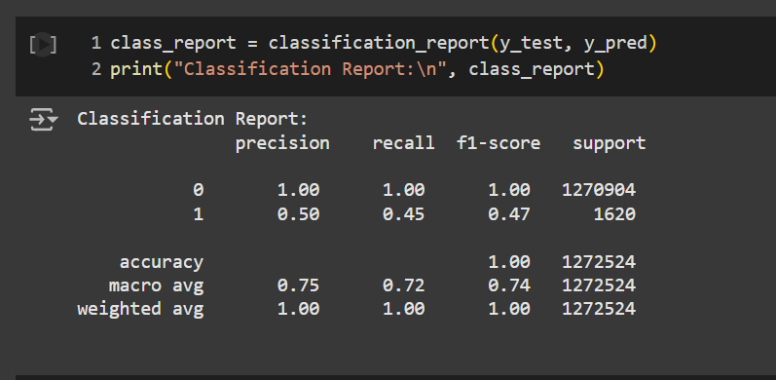
MODEL EVALUATION
LOGISTIC REGRESSION

Slide 11
CHALLENGES
SINCE OUT DATASET CONSIST OF MORE LEGIT TRANSACTION THAN FRAUDULENT TRANSACTION SO THERE IS A CLASS IMBALANCE
CLASS IMBALANCE
PATTERN IN FRAUD TRANSACTION
Identifying patterns in fraudulent transactions required feature engineering
FIRST CHALLANGES WAS SOLVING USING THE UPSCALING TECHNIQUE WHICH INVOLVES THE INCREASE IN NO. OF FRAUD TRANSACTION USING SOME TECHNIQUES AND SECOND CHALLANGES WAS SOLVED USING FEATURE ENGINEERING

Slide 12
FUTURE WORK
Advanced Sampling Strategies:
implement oversampling methods like SMOTE (Synthetic Minority Oversampling Technique) to balance the dataset and improve the model's ability to detect fraud.
Deep Learning Models:
Experiment with Neural Networks or Autoencoders for anomaly detection and feature extraction in complex datasets.
Investigate unsupervised approaches, such as Isolation Forest or One-Class SVM, to identify rare fraudulent patterns without relying solely on labeled data.
Anomaly Detection Methods:

Slide 13

CONCLUSION
Preliminary Models:
Successfully developed and trained fraud detection models using Logistic Regression and Decision Tree Classifier.
Data Preparation:
Implemented comprehensive preprocessing steps, including scaling, encoding, and outlier removal, to ensure data quality and model reliability.
Performance Evaluation:
Achieved satisfactory classification performance, addressing the challenges of imbalanced data and feature complexity.
Key Insights
Logistic Regression provided a strong baseline, while the Decision Tree offered interpretability and insights into feature importance.
Future Directions:
Plan to adopt advanced methods, such as ensemble learning and anomaly detection, to improve model accuracy and scalability further.

Slide 14
THANKS

